Slide 1
Stream Processing
With Kafka, scalaz, fs2 – experience report
jannmueller@sphonic.com
9 December 2016
Notes:
Experience report
Will look at some code for stream processing
Then try to generalise it a little
FS2 vs scalaz-streams

Slide 2

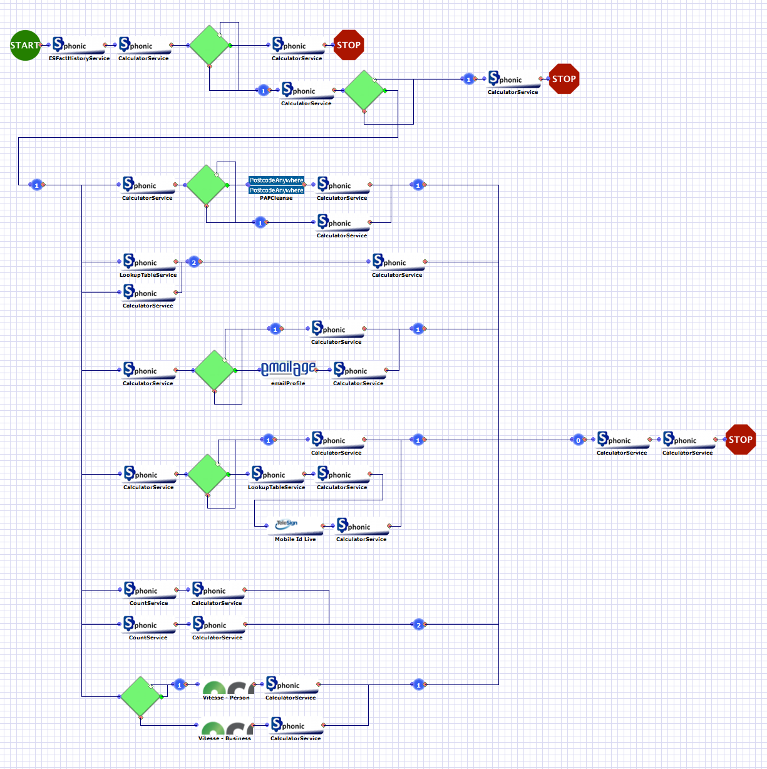
What we do
Fraud risk management
Address & age verification, anti-money laundering etc.
Aggregate data from ~60 3rd party APIs
Post-processing: data mining, analytics
Custom workflows for each client
Graphical editor + expression DSL
Notes:
Fraud and risk management
Transactional
Workflows tailored to clients needs/industry & country templates/etc

Slide 3
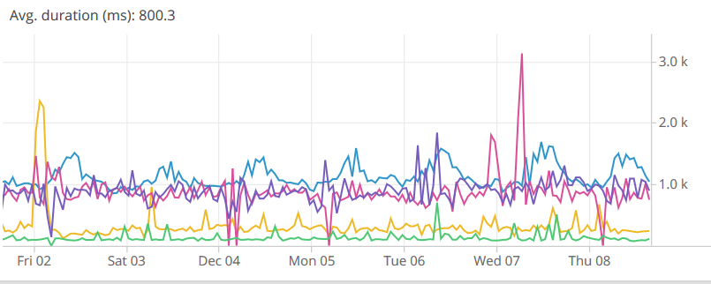
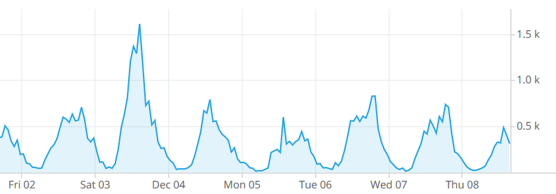
Performance & Scale
Relatively low tps (<10 on average), high variance
Batches
Seasonal/time-of-day
Latency highly dependent on API calls
Most time is spent waiting for other services
Notes:
Just to give an idea of the parameters
Not exactly big data
Can compute perf. Characteristics of workflow based on AST and historical data

Slide 4
Scala @ Sphonic
Current workflow engine:
Monolithic, hard to debug, does not scale etc.
BUT post-transaction processing already based on kafka
We implemented a proof-of-concept for 1 client
fs2, scalaz, finagle, finch, algebird, …
Good results, but workflow is hard-coded
To generalise it, we need a stream-based workflow execution engine
That’s what the rest of this talk is about
Notes:
Use scala for most things already
Kafka currently only used after a transaction has happened (aggregation etc)
Why kafka??
Have a dsl for workflows already, now need a new interpreter
We also do counts, etc.

Slide 5
Workflows as streams Architecture
3rd parties,
user input,
Other services
Service connector
HTTP API
Workflow engine
Post-processing
kafka
Notes:
All side-effects are encapsulated
Parallelism:
Run multiple service connectors, workflow engines based on partitions of the topic

Slide 6
Workflows as streams All side effects are events
Service connector
3rd parties,
Other services
HTTP API
Workflow engine
Post-processing
Long-running transactions!
Persistence!
Debugging!
Upgrades!
Scalacheck for workflows!

Slide 7

Workflows as streams Input & Output format
A transaction is a stream of APIResponses

Slide 8
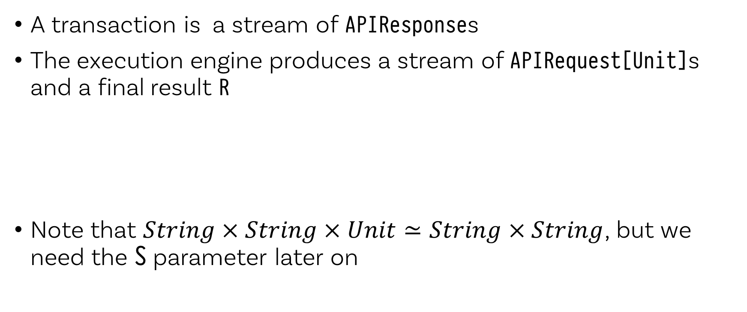
Workflows as streams Input & Output format
A transaction is a stream of APIResponses
The execution engine produces a stream of APIRequest[Unit]s and a final result R
Note that $String×String×Unit≃String×String$, but we need the S parameter later on

Slide 9
Workflows as streams Input & Output format
A transaction is a stream of APIResponses
The execution engine produces a stream of APIRequest[Unit]s and a final result R
Service connector
APIResponse
Transaction
APIRequest[Unit]
HTTP API
Workflow engine
R
Notes:
Important to have strongly typed topics
Thrift, json, etc
Need to store schema, versions, …

Slide 10
Workflows as streams Input & Output format
A transaction is a stream of APIResponses
The execution engine produces a stream of APIRequest[Unit]s and a final result R
Conceptually:

Slide 11
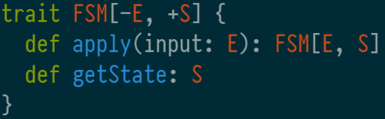
Workflows as streams Finite state machines (Moore)
Resumable / partial execution
BUT Cannot combine easily
Need some combinators to interpret our workflows
Notes:
Monad, comonad, functor, etc
Does not combine even though it has a monad instance (does the wrong thing)
Need a dsl that we can use to model workfows and then “compile” to FSM

Slide 12
Workflow DSL What is out there
Streams/iteratees
Many implementations: Machines (Haskell), scalaz-stream/fs2, …
Can be resumed
Do not support backtracking
Parser combinators
Backtracking
Cannot be resumed
Also, how can we do requests (to external services)?
Notes:
Streams do not support backtracking because they aim for constant memory usage
But we don’t care about that so much because a transaction typically has <50 events (tokens)

Slide 13
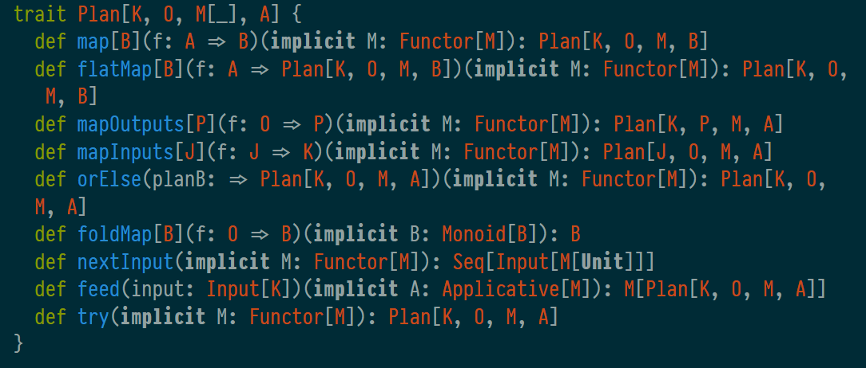
Workflow DSL Solution
Let’s build a hybrid
Notes:
Type parameters!! K, O, M, A
Simplified (nextInput, feed should be in different trait)
INPUT will be explained in a minute

Slide 14
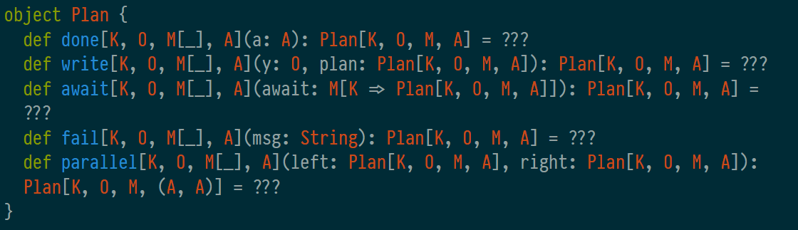
Workflow DSL Solution
Notes:
Final encoding (GADTs due to `parallel`)
Now going to talk about some specific problems, (where the impl. differs from other libraries)

Slide 15
Parallel Branches
Branches of a workflow can run in parallel
In parallel.feed we need to know which branch to run

Slide 16
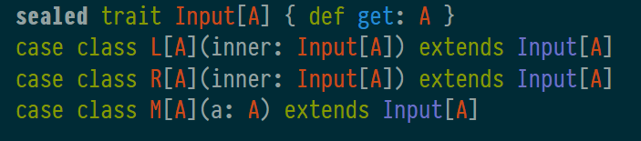
Parallel Branches
Branches of a workflow can run in parallel
In parallel.feed we need to know which branch to run
So we encode the branch in the input type:

Slide 17
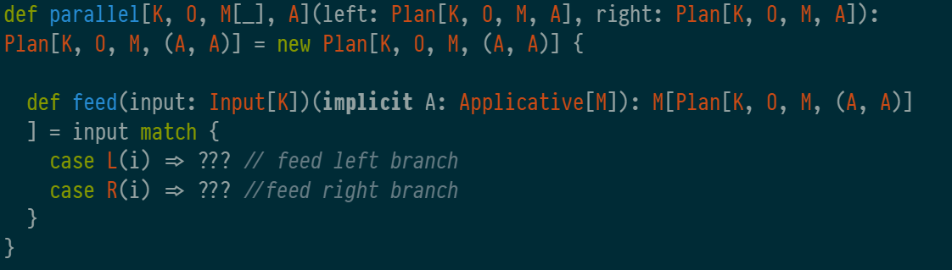
Parallel Branches
Branches of a workflow can run in parallel
In parallel.feed we need to know which branch to run
So we encode the branch in the input type
Notes:
* In all other plan types we match on M(_)

Slide 18
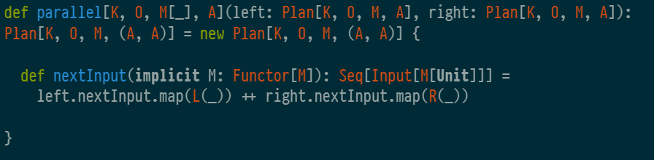
Parallel Branches
Branches of a workflow can run in parallel
In parallel.feed we need to know which branch to run
So we encode the branch in the input type
And wrap the inputs in parallel.nextInputs
Notes:
* In all other plan types we match on M(_)

Slide 19
Requesting Input
await needs to specify the request parameters
Which service to call, arguments, etc.

Slide 20
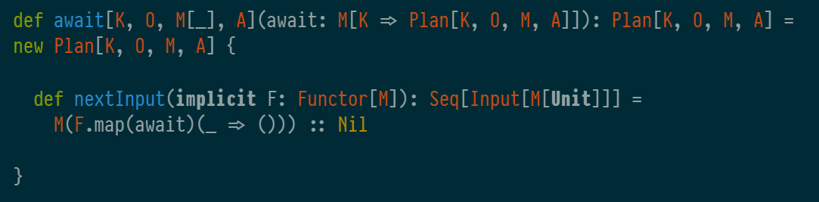
Requesting Input
await needs to specify the request parameters
Which service to call, arguments, etc.
In nextInput we return M[Unit]

Slide 21
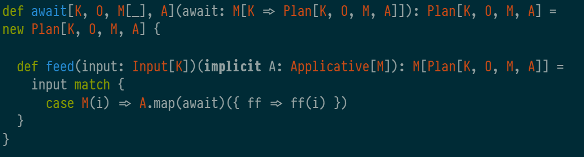
Requesting Input
await needs to specify the request parameters
Which service to call, arguments, etc.
In nextInput we return M[Unit]
In feed we unwrap the innermost Input value
Notes:
* Partial match…

Slide 22

Requesting Input
The service connector implements Input[M[Unit]] => Input[K]
This means that K should be able to express failed requests
We want to handle most failures in the workflow language
For example, retries can be done without a round trip to the workflow engine, but failover (vendor down) should be managed in the workflow
Service connector
3rd parties,
Other services
HTTP API
Workflow engine
Post-processing
Notes:
* Vendor calls have a cost & other commercial impliciations so need to be managed in the language, not implicitly

Slide 23
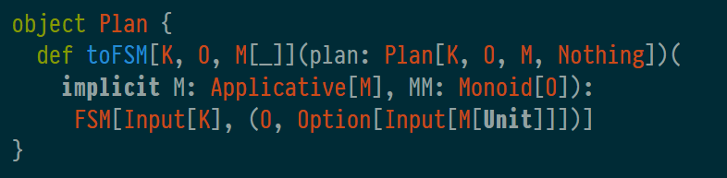
Workflow DSL Generating a finite state machine
Run a plan on a sequence of inputs
Collect partial results along the way
Notes:
Nothing type
Monoid (partial results)

Slide 24
Workflow DSL Generating a finite state machine
Run a plan on a sequence of inputs
Collect partial results along the way
To get a Plan[K, O, M, Nothing]:
Notes:
Nothing type
Monoid (partial results)

Slide 25
Workflow DSL Using the language
We store workflows as ASTs and interpret them using the Plan combinators
But we can also write workflows in Scala directly (embedded DSL)
Notes:
Final encoding (GADTs due to `parallel`)

Slide 26

Workflow DSL Using the language
We store workflows as ASTs and interpret them using the Plan combinators
But we can also write workflows in Scala directly (embedded DSL)
The output type should have an associative operation to enable intermediate results – scalaz.Semiring[O]
For example:
Notes:
Final encoding (GADTs due to `parallel`)

Slide 27
Workflow DSL Using the language
We store workflows as ASTs and interpret them using the Plan combinators
But we can also write workflows in Scala directly (embedded DSL)
The output type should be monoidal to enable intermediate results – scalaz.Monoid[O]
If there are no reasonable append/zero operations, use Last[O]
Notes:
Final encoding (GADTs due to `parallel`)

Slide 28
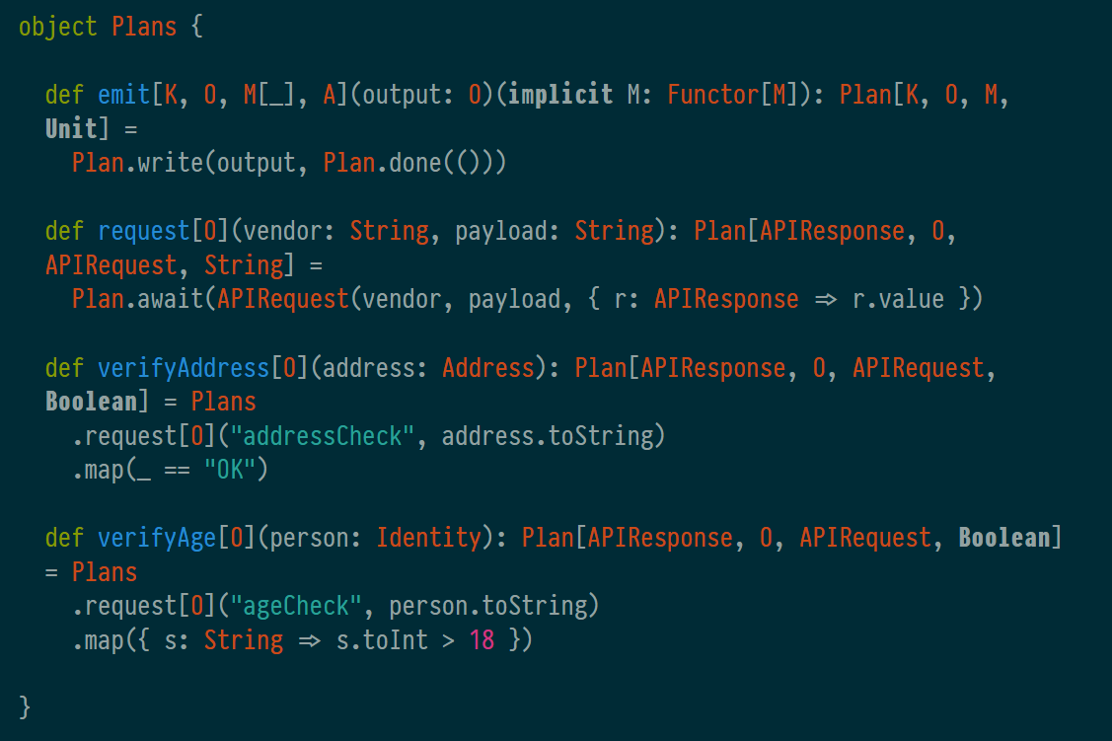
Workflow DSL Conveniences
Notes:
Final encoding (GADTs due to `parallel`)

Slide 29
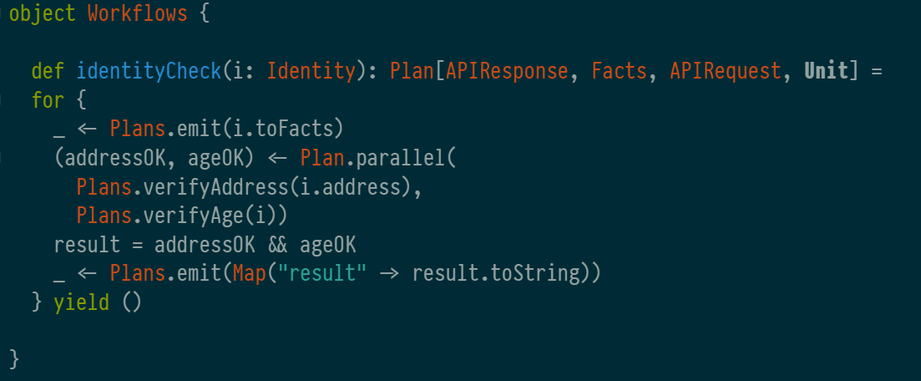
Workflow DSL Example

Slide 30

Working with workflows Property tests
Define case classes & arbitrary instances for each kind of input data
Notes:
Nothing type
Monoid (partial results)

Slide 31
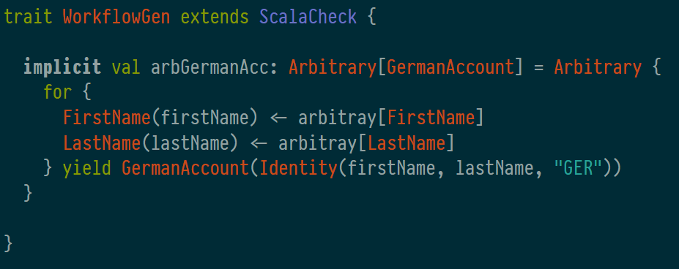
Working with workflows Property tests
Define case classes & arbitrary instances for each kind of input data
Notes:
Nothing type
Monoid (partial results)

Slide 32
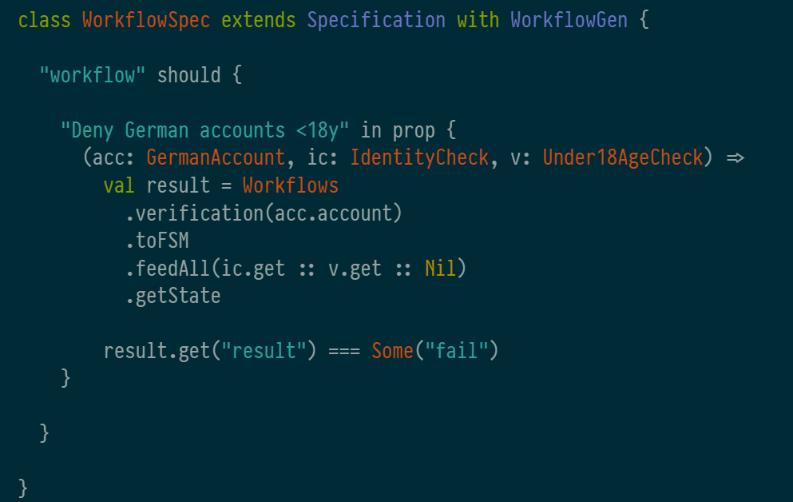
Working with workflows Property tests
Define case classes & arbitrary instances for each kind of input data
Notes:
Nothing type
Monoid (partial results)

Slide 33
Working with workflows Upgrade running transactions to a new version
Try to parse all events for that transaction using the new version
Revert to old version on failure
This is safe because it doesn’t have cause any side effects

Slide 34
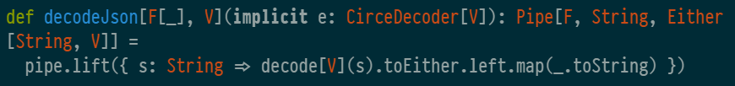
Pieces of the puzzle Running the workflow engine on kafka
Serialise to/from JSON
Because it can be derived automatically with circe
Alternatively, use binary format eg. thrift
Notes:
* Did some performance testing, reached > 1400 tps on a single partition (just kafka/fs2/circe), chose not to investigate further

Slide 35
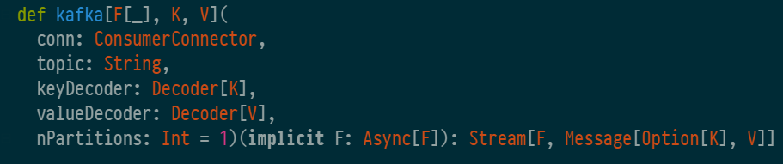
Pieces of the puzzle Running the workflow engine on kafka
FS2 kafka stream
ConsumerConnector (kafka) gives 1 iterator for each partition
Create 1 stream per partition and join with fs2.concurrent.join
Notes:
* Did some performance testing, reached > 1400 tps on a single partition (just kafka/fs2/circe), chose not to investigate further

Slide 36
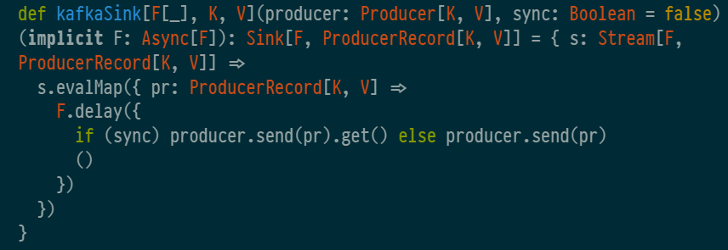
Pieces of the puzzle Running the workflow engine on kafka
FS2 kafka stream
Write to another topic when done
Notes:
* Did some performance testing, reached > 1400 tps on a single partition (just kafka/fs2/circe), chose not to investigate further

Slide 37
Pieces of the puzzle Running the workflow engine on kafka
FS2 pipeline to…
Fetch from kafka
Deserialise records
Keep track of intermediate state for all running transactions
RocksDB, but RAM would work just as well
Feed new records to the relevant transaction (or initialise if not present)
Check output
If Some(APIRequest), write to API request topic
If None, write results to results topic and empty cache

Slide 38
Caveats
Make sure to not run out of memory
Cache everything with RocksDB, no state in RAM
Or: Sliding window
Futures
Three different implementations (scalaz, twitter-util, scala)
So we need 6 conversions

Slide 39
References
http://hackage.haskell.org/package/machines-0.6
http://comonad.com/reader/wp-content/uploads/2009/08/A-Parsing-Trifecta.pdf

Slide 40
Additional material

Slide 41
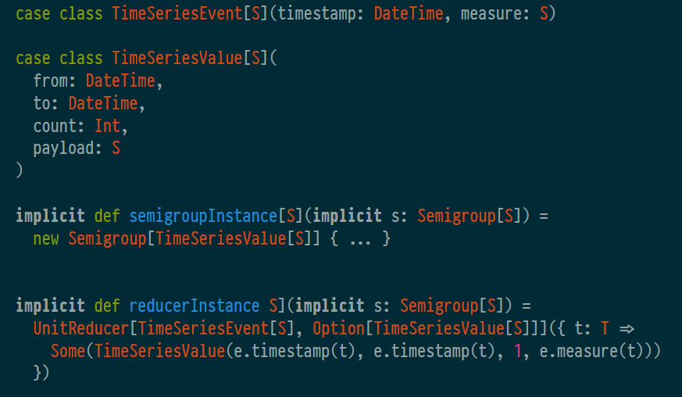
Caveats
Make sure to not run out of memory
Cache everything with RocksDB, no state in RAM
Or: Sliding window
Scalaz FingerTree for querying a time series on O(log(n))

Slide 42
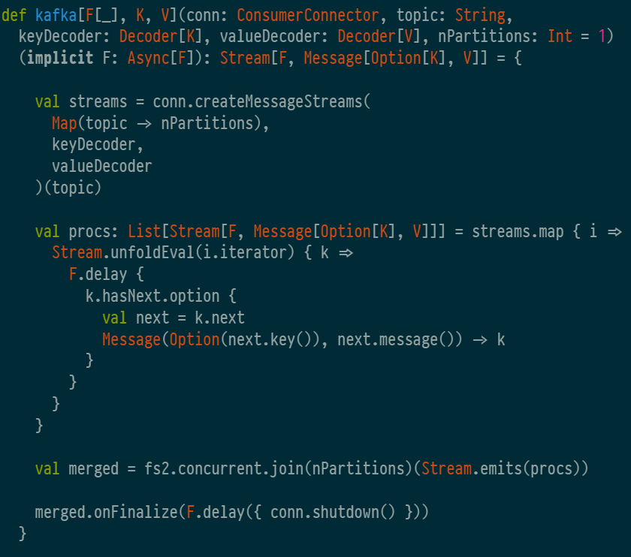
Kafka connector

